Slide 1
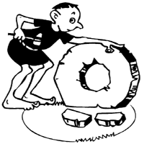
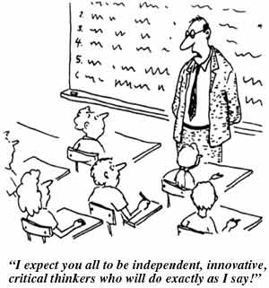

How to Promote Deep Learning
Dr. Julian Hermida
Algoma University
Workshop on Teaching
and Learning
January 21, 2009

Slide 2

Agenda
Workshop objectives
Introduction: Deep Learning
Video
Research findings on deep learning
Videos to foster discussion
Group discussion
Group activity
Resources: www.julianhermida.com

Slide 3
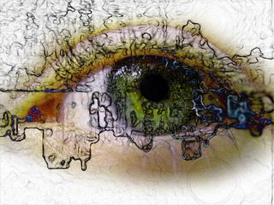
What is deep learning?
A SOTL constructivist approach
Use of higher-order cognitive and meta-cognitive skills in order to construct long-term understanding.
Link of new ideas to already known concepts.
Use of new concepts to solve problems in new and unfamiliar contexts.
A sustained, substantial, and positive influence on the way students act, think, or feel.
Personal commitment to learning.

Slide 4
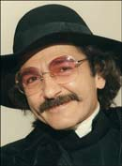
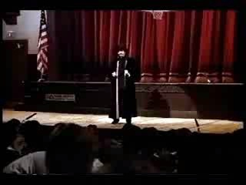
Surface Learning

Slide 5
Discussion Questions
Does this happen here at Algoma?
Do you agree that most students forget almost everything they learn in college?
Why does this happen?

Slide 6


Deep learning | Surface learning
The deeper the student’s approach to learning, the higher the quality of the learning outcome
Knowledge is constructed. Natural critical learning environment. | Knowledge is received.
Search for meanings. Student learning activities. | Search for facts.
Higher-order cognitive skills. | Lower-order cognitive skills.
Intrinsic motivation. Motivation as a product of teaching. | Extrinsic motivation.
Approaches to learning arise from the students perceptions of the teachers’ requirements.
Constructive alignment | Unaligned courses.
Metacognition | Study for exams.
Discovery | Coverage
Focus on what the student does. | Focus on what the teacher does.

Slide 7



Deep Learning Video

Slide 8

Video activity

Slide 9
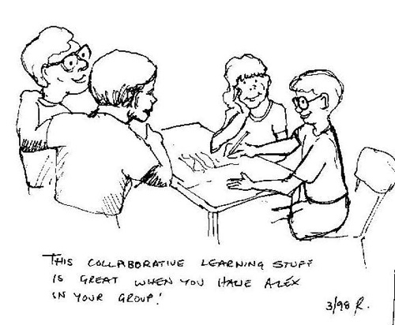

Group discussion
Does each of these scenes promote deep learner?
Why? Why not?
What do we usually do in our courses
that results in surface learning?
What do we need to do to encourage our students to take a deep approach to learning? How can we teach so that Robert becomes like Susan? Think of a course you are teaching/taking, what specific changes would you introduce to promote deep learning?
Create an expectation failure for students in one of your courses.
Notes:
Variedad

Slide 10
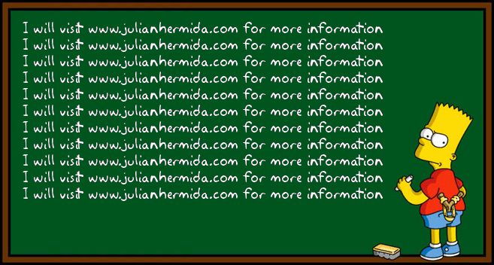

Conclusions

