Slide 1


To Lecture or not to lecture? That is the question
Dr. Julian Hermida
Algoma University
Teaching Forum
Academic Standards and
Teaching & Learning
Committee
March 13, 2009

Slide 2

Agenda
Objective
Introduction
Video for input
Group discussion
The deep-learning lecture
Video for input: Declining by Degrees
Group discussion
Resources: www.julianhermida.com
Next session: Eileen Herteis -April 17

Slide 3
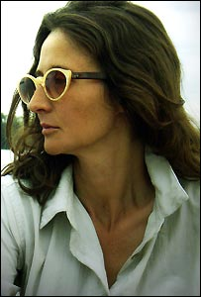
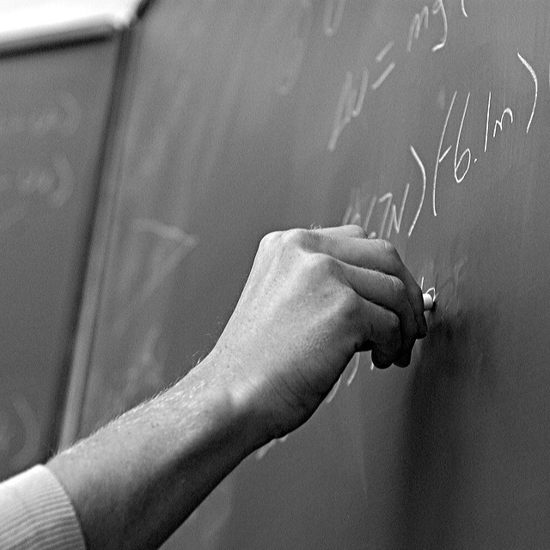
Why do we lecture?
Signature pedagogy of
undergraduate liberal arts education.
Importance of the problem.
Classroom action research.

Slide 4
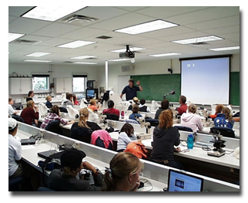
My classroom action research
Traditional lectures.
Student-driven course.
Deep-learning lectures.

Slide 5

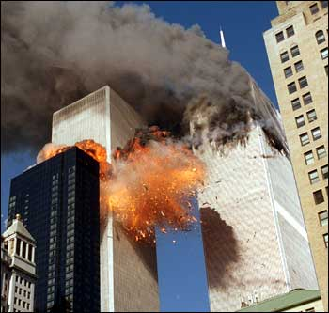
September 11: The effects of lectures

Slide 6

Famous lecturers

Slide 7
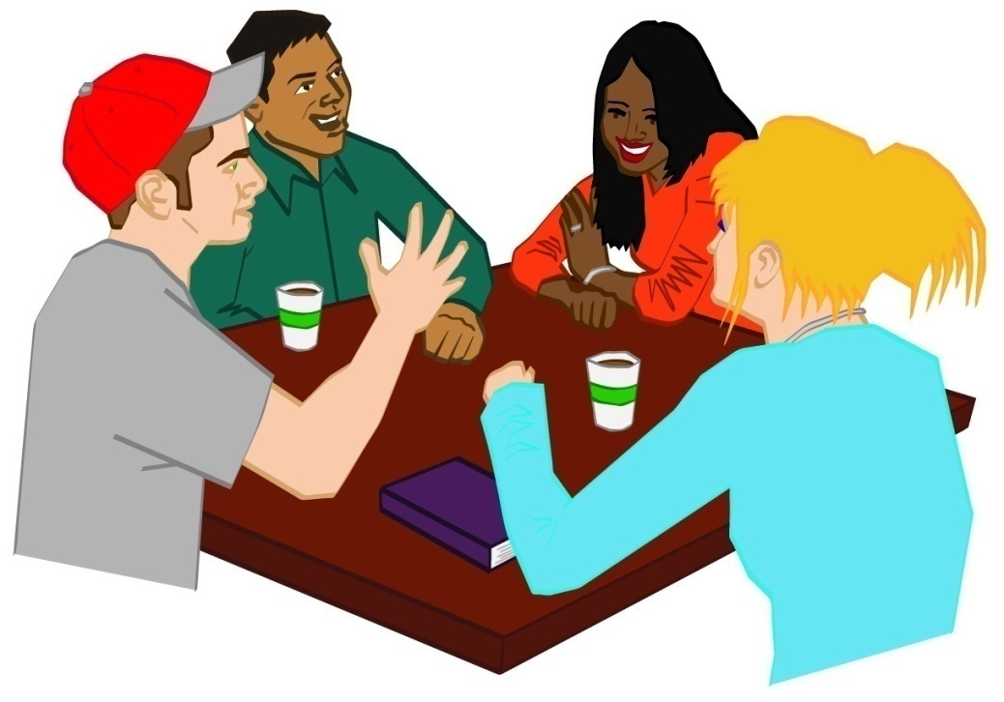
Group discussion
Why do we lecture?
What do you want to accomplish
when you lecture?
What’s right/wrong with lectures?
Do you think that most students like the traditional lecture format?

Slide 8
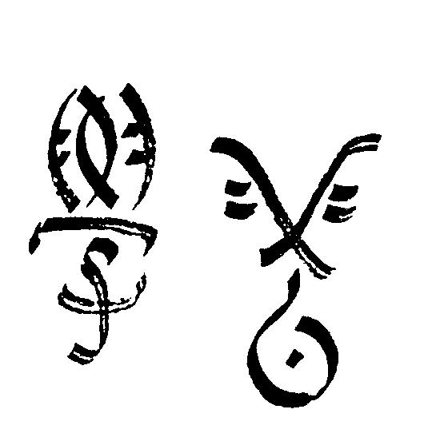
The Deep-Learning Lecture
Use of higher-order cognitive
and meta-cognitive skills to
construct long-term understanding.
Intrinsic motivation.
Discovery rather than coverage.
Focus on what students do.
Challenge to the mental models of reality.
Student collaboration to learn.
Constructive alignment.
Formulation of ideas in writing.

Slide 9

Structure of the deep-learning lecture
Question/problem
Significance of the question
Engagement of students
in higher-order thinking.
Construction of a tentative
answer or solution
A new question of problem

Slide 10


Declining By Degrees

Slide 11

Group activity
What, if any, is the connection between
traditional lectures and surface learning?
Are students sleepwalking through college?
If so, is it the result of lectures and the way we teach?
Is there an unspoken social contract?
Are there any institutional barriers to move away from traditional lectures to lectures that foster deep learning? What are these barriers?
What are the benefits of deep-learning lectures? What, if any, are the drawbacks?
For the most daring only, design a deep learning lecture. If you are up to the challenge, ask me for the instructions.

Slide 12
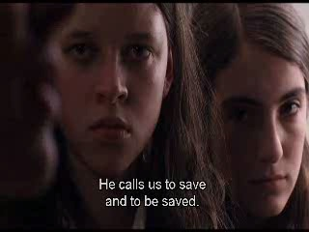
Results of my action research project

Slide 13
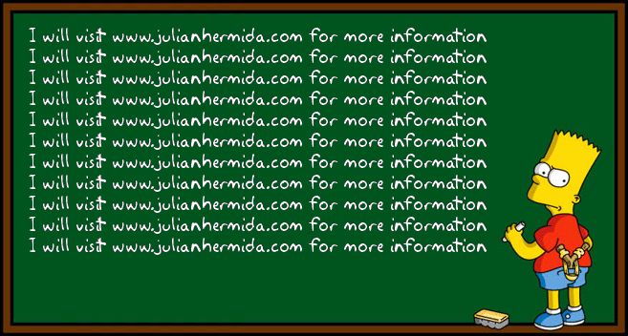
Resources
For further resources, please visit www.julianhermida.com and check on Teaching and Learning.

Slide 14

SOLO Taxonomy
Level 5: Extended abstract
Level 4: Relational
Level 3: Multistructural
Level 2: Unistructural
Level 1: Prestructural

Slide 15

Levels of thinking about teaching
Level 1: What the student is.
Level 2: What the teacher does.
Level 3: What the student does.

Slide 16
CONSTRUCTIVE ALIGNMENT
Curriculum objectives and intended learning outcomes
Assessment
Teaching and Learning Activities

Slide 17

New questions
How do you understand the
problem of traditional lectures now?
What are the characteristics
and elements of an outstanding lecture?
What are the problems that may arise once we move away from traditional lectures to lectures that foster deep learning?

