Slide 1


Teaching and Learning Activities for Deep Learning
Dr. Julian Hermida
Algoma University
Workshop on
Teaching and Learning
February 18, 2009

Slide 2

Agenda
Objective: TLAs that promote deep learning.
Interactive talk: TLAs and deep learning.
Group activities: case studies, Socratic method.
Conclusions
February 25: Student assessment
Resources: www.julianhermida.com

Slide 3

Deep Learning
Use of higher-order cognitive
and meta-cognitive skills to
construct long-term understanding.
Intrinsic motivation.
Discovery rather than coverage.
Focus on what students do .
Challenge to the mental models of reality.
Student collaboration to learn.
Formulation of ideas in writing.

Slide 4
Learning outcomes
Constructive alignment
Learning outcomes: both content
and process skills stated in terms of
the nature of the understanding.
SOLO taxonomy

Slide 5


Slide 6
Levels of thinking about teaching
Level 1: What the student is.
Level 2: What the teacher does.
Level 3: What the student does.

Slide 7
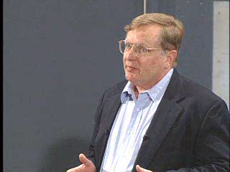
Levels

Slide 8
Levels of Thinking about Teaching: Discussion
What levels of teaching do these teachers represent?
Are they effective? Who is more effective? Who promotes student deep learning?

Slide 9
Types of Knowledge
Declarative knowledge.
Functioning knowledge.

Slide 10
TLAs and Deep Learning
Socratic method.
Case studies and problem-based learning.

Slide 11
Case studies
Discuss the following cases in small groups.
Then we will analyze them together.

Slide 12
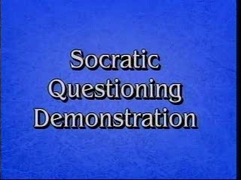

Slide 13
Socratic method
One of you will be the Socratic facilitator.
Facilitate the following discussion: Can the Socratic method be used to promote deep learning with our students?

Slide 14

bart
Notes:
Variedad

Slide 15
CONSTRUCTIVE ALIGNMENT
Curriculum objectives and intended learning outcomes
Assessment
Teaching and Learning Activities

Slide 16

SOLO Taxonomy
Level 5: Extended abstract
Level 4: Relational
Level 3: Multistructural
Level 2: Unistructural
Level 1: Prestructural

