Slide 1


Developing a Deep-Learning Course
Dr. Julian Hermida
Algoma University
Workshop on
Teaching and Learning
February 4, 2009

Slide 2

Agenda
Objectives: Develop a course that promotes deep learning
Interactive talk: Course development and deep learning
Group activities: learning outcomes, the promising syllabus, analysis of course syllabi.
Conclusions
Resources: www.julianhermida.com

Slide 3

Deep Learning
Use of higher-order cognitive
and meta-cognitive skills to
construct long-term understanding.
Intrinsic motivation.
Discovery rather than coverage.
Focus on what students do .
Challenge to the mental models of reality.
Student collaboration to learn.
Formulation of ideas in writing.

Slide 4

Teaching Process
Vision
  A vision of the possible or an experience of the problematic.
Design
  Background design
Enactment
Outcomes
Analysis

Slide 5

Learning outcomes
Big questions in your discipline.

Slide 6

Learning outcomes
Constructive alignment
Learning outcomes: both content
and process skills stated in terms of
the nature of the understanding.
SOLO taxonomy

Slide 7

Types of Course Syllabi
The Minimalist Syllabus.
The Practical Syllabus.
The Demanding Syllabus.
The Learning Centered Syllabus.
The Promising Syllabus.

Slide 8

The Promising Syllabus
The promise and invitation
An invitation to the work
that will fulfill the promises
The beginning of a conversation about the ways for the student and teacher to understand the nature and progress of student learning

Slide 9

Analysis of course syllabi
Is it a promising syllabus?
Is the course aligned? Why? Why not?
Do the learning outcomes aim at promoting deep learning? Why? Why not?
How can you reformulate the learning outcomes so as to promote deep learning?

Slide 10

The Course Portfolio
A tool for the Scholarship of Teaching and Learning
An opportunity to investigate student learning.
    Attainment of course objectives
A way to market your teaching.

Slide 11
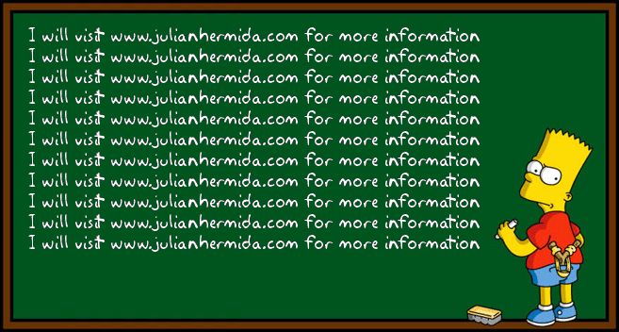
bart
Notes:
Variedad

Slide 12
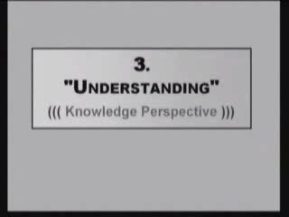
The Solo Taxonomy

Slide 13
Big questions
If Father Guido Sarducci hired you to teach your discipline at the Five Minute University, what big question/s would you like your students to answer? What skills will your students need to answer that question?
How will you encourage your students’ interest in those questions and skills?

Slide 14
The Promising Syllabus
Tell your colleague about the promise you would like to make to your students and the invitation to the work that will fulfill that promise.
Your colleague will write the promise and invitation for you.
Now listen to your colleague and write the promise and invitation for her/his course.

