Slide 1


Assessment for Deep Learning
Dr. Julian Hermida
Algoma University
Workshop on
Teaching and Learning
February 25, 2009

Slide 2

Agenda
Objective: Student assessment that promotes deep learning.
Interactive talk: Review of main concepts. Assessment and deep learning.
Group activities: case studies, group discussions.
Conclusions
March 11: Microteaching: putting it all together
Resources: www.julianhermida.com

Slide 3

Deep Learning
Use of higher-order cognitive
and meta-cognitive skills to
construct long-term understanding.
Intrinsic motivation.
Discovery rather than coverage.
Focus on what students do .
Challenge to the mental models of reality.
Student collaboration to learn.
Formulation of ideas in writing.

Slide 4

Learning outcomes
Constructive alignment
Learning outcomes: both content
and process skills stated in terms of
the nature of the understanding.
SOLO taxonomy

Slide 5

Levels of thinking about teaching
Level 1: What the student is.
Level 2: What the teacher does.
Level 3: What the student does.

Slide 6

Types of Knowledge
Declarative knowledge.
Functioning knowledge.

Slide 7
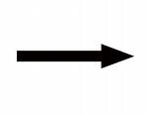
Student’s perceptions of assessment
Teacher’s ILO
↑
↓
Students’ Assessment
Assessment
Outcomes
Teaching activities
Learning activities
Notes:
How students learn depends on how they think they
will be assessed.
Assessment defines the actual curriculum
and the approach to learning.

Slide 8

Declining by Degrees

Slide 9

Group discussion
Is there grade inflation? Is it truly a problem?
Is there pressure from students about grades? Is there pressure from the administration?
Can students get good grades without studying deeply? Why? Are they sleepwalking through college?
Is there an unspoken social contract?
Do you have to make compromises? Do you often change your grades up after finishing marking so that your students will feel better?
What does it mean to be an A student today?

Slide 10

Formative vs. summative assessment
Formative | Summative
A powerful TLA. | Assessment.
Error detection as the basis for error correction. Freedom to admit errors. | Error signals punishment. It does not instruct.
Performance is matched as it is. | Performance is matched as it should be.
Continuous assessment is problematic when used for. (show and hide error at the same time)

Slide 11
Models of assessment
Measurement | Standards
Quantitative: how much the students know | Qualitative: changes in performance as a result of learning. How well the students know
Level 1 of teaching model. Grading on the curve. | Level 3
Levels 2 and 3 of the SOLO taxonomy | Levels 4 and 5
Marking: quantifying learning performances by transforming them into units or by allocating marks on a subjective basis. Assumptions: percentages are universal, knowledge is quantifiable and divisible | Subjective judgments.
Reliability: a property of the test, statistics. | Very clear about what we are doing, what learning outcomes we want, what is to be the evidence of those outcomes and why.
Uniformity. | Students learn and perform optimally with different formats of assessment.
Results: expressed in terms of comparisons. | Judgments are made in terms of how well student’s performance matches criteria set in advance
Analytic assessment: task reduced to its components. Only used in schools. | Holistic assessment: assessment of the total performance, not parts.
Assessment of the task. Goal: maximizing marks. | Assessment of student’s performance on the ILO. The AT is a source of evidence of student’s achievement of the ILO. Goal: Seeing the overall structure of what is being learned
Decontextualized. | Authentic and contextualized.
Notes:
Authentic and performance assessment: performance that reflects the kind of understanding that requires an active demonstration of the knowledge in question, as opposed to talking or writing about it.
Contextualized

Slide 12

Assessment of functioning knowledge
Portfolios.
Projects: capstone, individual, group.
Presentations.
Reflective journals.
Case study.
Problem solving.
Freedom to choose: “This is what I got out of the class. I have learned these things, and as a result my thinking has changed in the following ways.”
.

Slide 13

Metacognition
Thinking about your thinking.
Three components:
  Awareness of the most effective learning strategy.
  Knowledge about the learning process.
  Control: monitoring your own learning progress.

Slide 14
Metacognition
Is my course aligned? Are the ILOs consistent with the TLAs and the student assessment?
Do I know my students well enough? Do I know about their existing mental models of reality?
Are my ILOS appropriate for the students I am teaching? Am I aiming high enough? Do my TLAs try to help students use higher-order cognitive skills?
Do my TLAs to promote functioning knowledge? Have I created expectation failures? Am I fostering critical thinking? Am I helping my students develop a wide array of skills and competencies?
Am I helping my students discover knowledge by themselves?
Does the assessment of student work promote the use of higher-order cognitive skills? Does the assessment aim at encouraging deep learning? Am I following a standards model of assessment?
Am I promoting metacognition?
Am I giving effective feedback? Am I giving students the opportunity to try, fail, and receive feedback separate from and independent of any judgment of their efforts?
Am I intrinsically motivating students? Am I helping my students engage in the discipline?
Am I trying to foster my students to take a deep approach to learning?

Slide 15

Case studies
Discuss the following cases
in small groups.
Then we will analyze them together.

Slide 16
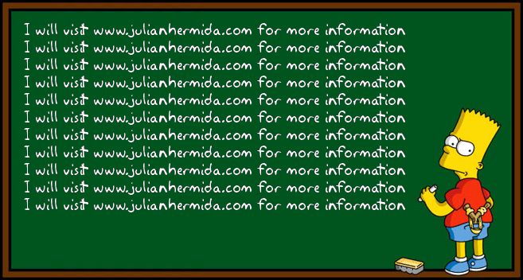
bart
Notes:
Variedad

Slide 17
CONSTRUCTIVE ALIGNMENT
Curriculum objectives and intended learning outcomes
Assessment
Teaching and Learning Activities

Slide 18

SOLO Taxonomy
Level 5: Extended abstract
Level 4: Relational
Level 3: Multistructural
Level 2: Unistructural
Level 1: Prestructural

