Slide 1


The Importance of Teaching Academic Reading Skills in First Year University Courses
Dr. Julian Hermida
Algoma University
Association of Atlantic Universities
Teaching Showcase
University of New Brunswick
Saint John, October 25, 2008
www.julianhermida.com

Slide 2

Agenda
Objective
Deep vs. surface reading
Video: Surface Reading and Learning
Constructive alignment
Strategies to promote deep reading
Categories of analysis
Examples of reading activities
The Apprentice
Resources: www.julianhermida.com

Slide 3

Deep vs. surface reading

Slide 4

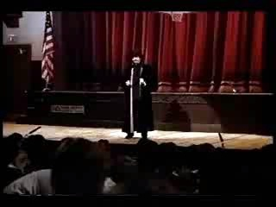
Surface Reading and Surface Learning

Slide 5
Constructive alignment
Curriculum objectives and intended learning outcomes
Assessment
Teaching and Learning Activities

Slide 6

Strategies to promote a deep approach to reading academic texts
Don’t lecture the texts.
In-class reading activities.
Manageable reading loads.
Explain the relevance of texts.
Aim reading materials at the level
of the majority of students.
Explain academic reading strategies.

Slide 7

General categories of analysis
Reading purpose
Context
Thesis
Deconstruction of assumptions
Evaluation of author’s arguments
Consequences of author’s arguments

Slide 8

Specific categories of analysis
Approach to law
Legal theory
Rationality of the
legal argument
Legal tradition
Comparative Law
Policy implications and social consequences

Slide 9

Examples of reading activities
Reading texts in class.
Games (The Amazing
Race, The Apprentice)
Double-entry journals.
Concept maps.

Slide 10


The Apprentice

Slide 11

Conclusions
For further resources, please visit www.julianhermida.com and check on Teaching and Learning.

